Slide 1
heaps

Slide 2
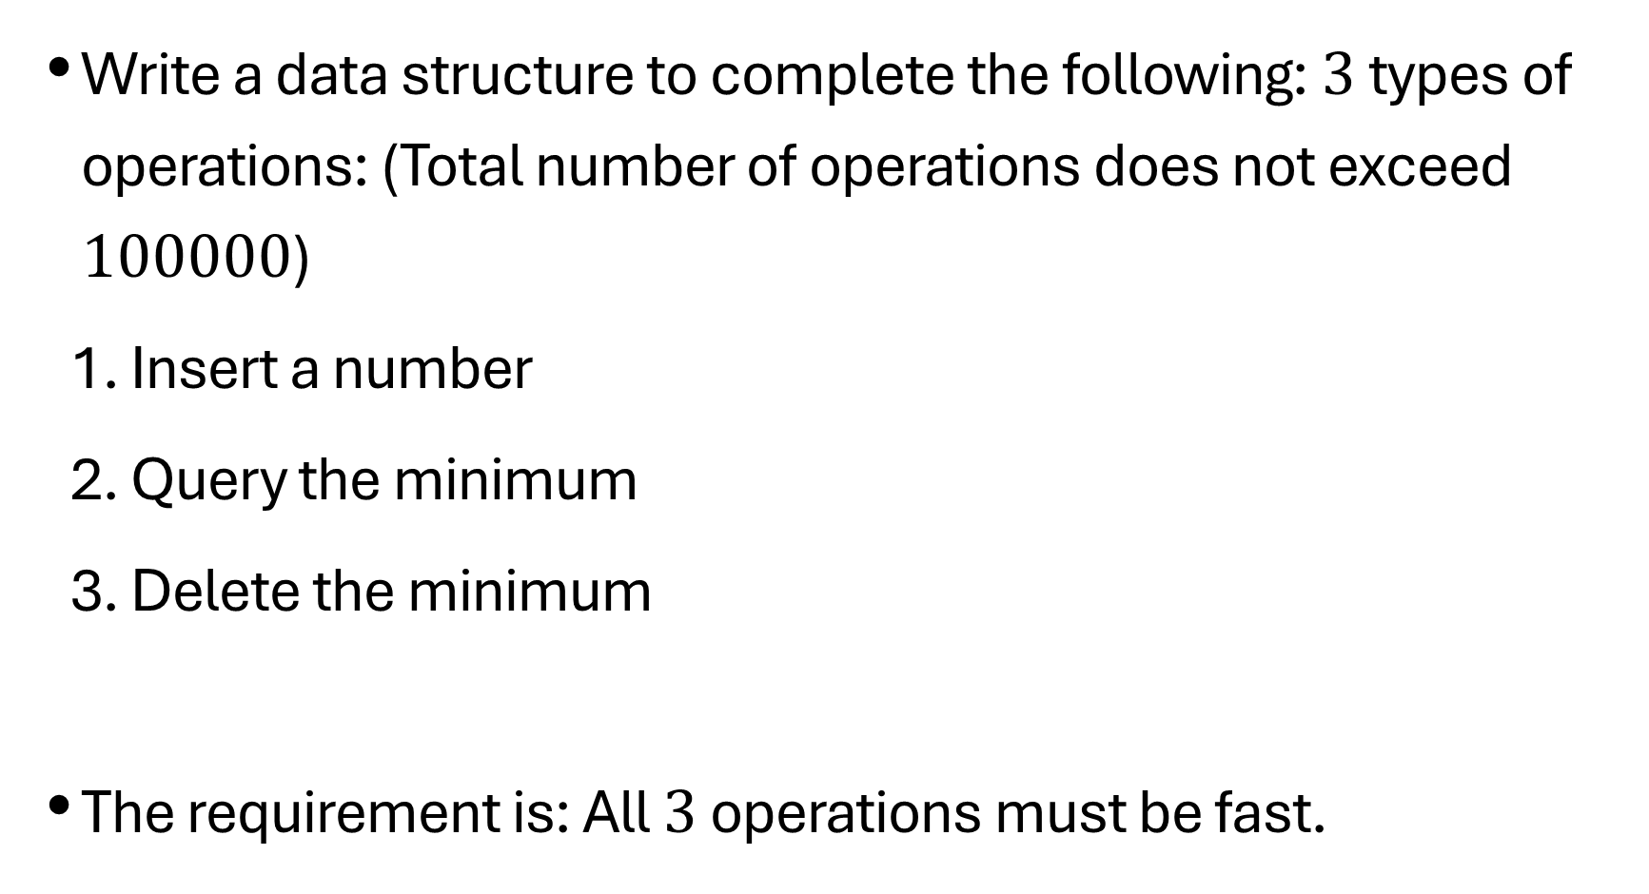
Problem: Finding the maximum/minimum element of arbitrary data
Write a data structure to complete the following: $3$ types of operations: (Total number of operations does not exceed $100000$)
1. Insert a number
2. Query the minimum
3. Delete the minimum
The requirement is: All $3$ operations must be fast.

Slide 3
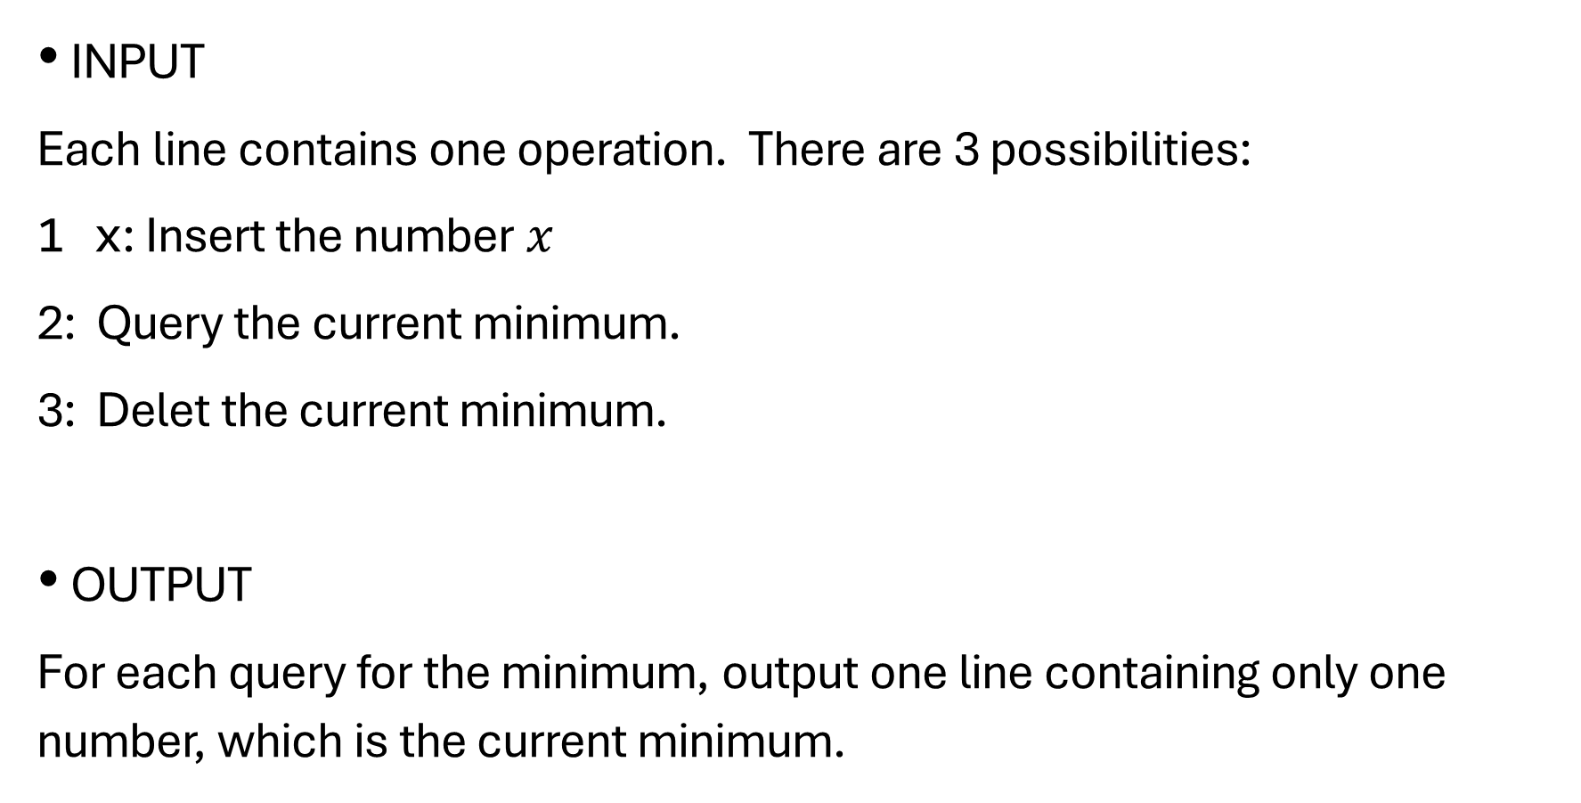
Input / Output
INPUT
Each line contains one operation. There are 3 possibilities:
1 x: Insert the number $x$
2: Query the current minimum.
3: Delet the current minimum.
OUTPUT
For each query for the minimum, output one line containing only one number, which is the current minimum.

Slide 4
Sample
INPUT:
9 ----- 9 operations
1 20
2
1 30
1 10
2
3
2
3
2
OUTPUT:
20
10
20
30

Slide 5

Using linear lists as the data structure
Unordered list:
  Insertion operation $O\left(1\right)$
  Query minimum value $O\left(n\right)$
  Delete minimum value $O\left(n\right)$
Ordered list:
  Insertion operation$O\left(n\right)$
  Query minimum value$O\left(1\right)$
  Delete minimum value$O\left(1\right)$

Slide 6
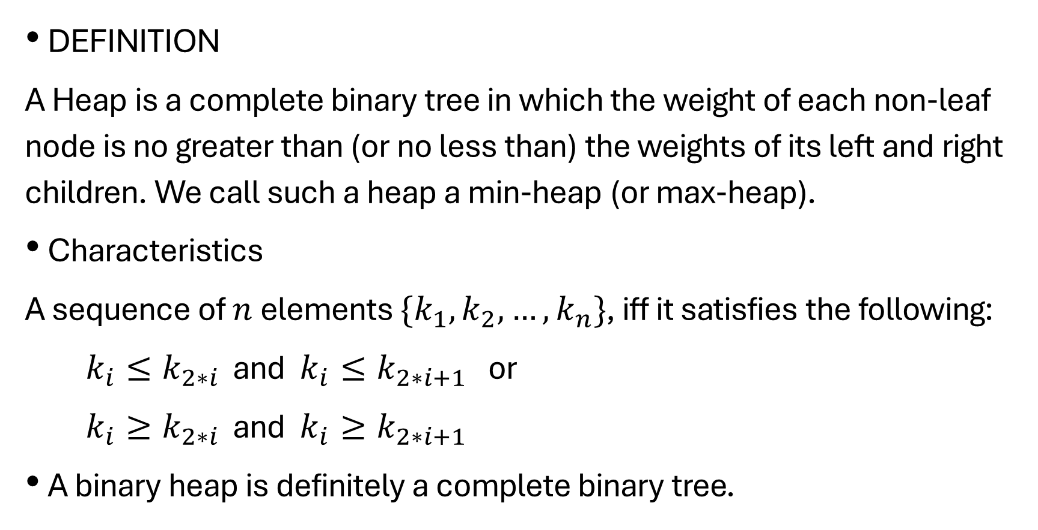
Binary heaps (priority queues)
DEFINITION
A Heap is a complete binary tree in which the weight of each non-leaf node is no greater than (or no less than) the weights of its left and right children. We call such a heap a min-heap (or max-heap).
Characteristics
A sequence of $n$ elements $\{k_{1},k_{2},…,k_{n}\}$, iff it satisfies the following:
$k_{i}≤k_{2∗i}$ and $k_{i}≤k_{2∗i+1}$ or
$k_{i}≥k_{2∗i}$ and $k_{i}≥k_{2∗i+1}$
A binary heap is definitely a complete binary tree.

Slide 7
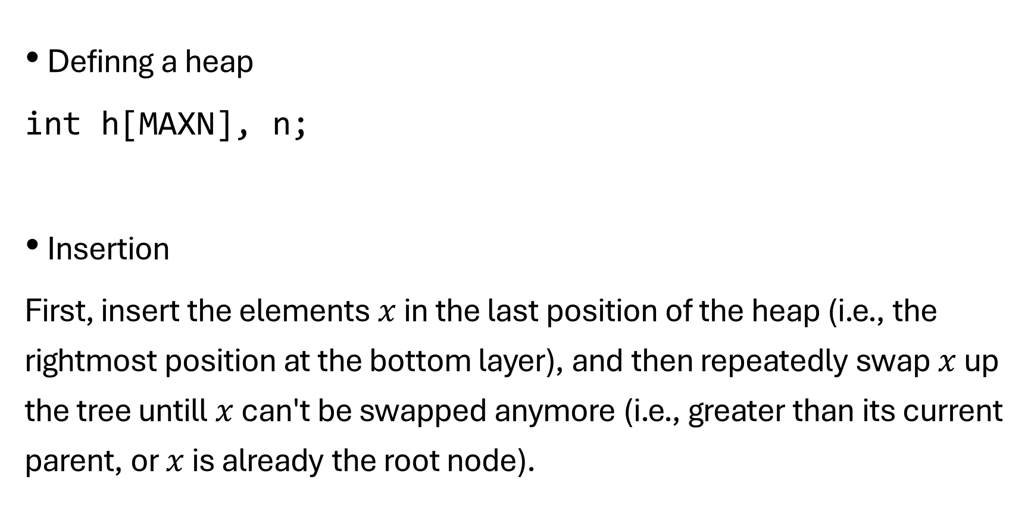
INSERTING NODE X INTO THE HEAP
Definng a heap
int h[MAXN], n;
Insertion
First, insert the elements $x$ in the last position of the heap (i.e., the rightmost position at the bottom layer), and then repeatedly swap $x$ up the tree untill $x$ can't be swapped anymore (i.e., greater than its current parent, or $x$ is already the root node).

Slide 8
1
1
3
5
3
5
4
5
7
8
2
5
7
8
6
2
6
4
(1) Insert the new node at the end
(2) Swap the new node with its parent node.
1
2
5
3
5
7
8
6
4
(3) Continue swapping until the heap characteristics is satisfied again.

Slide 9
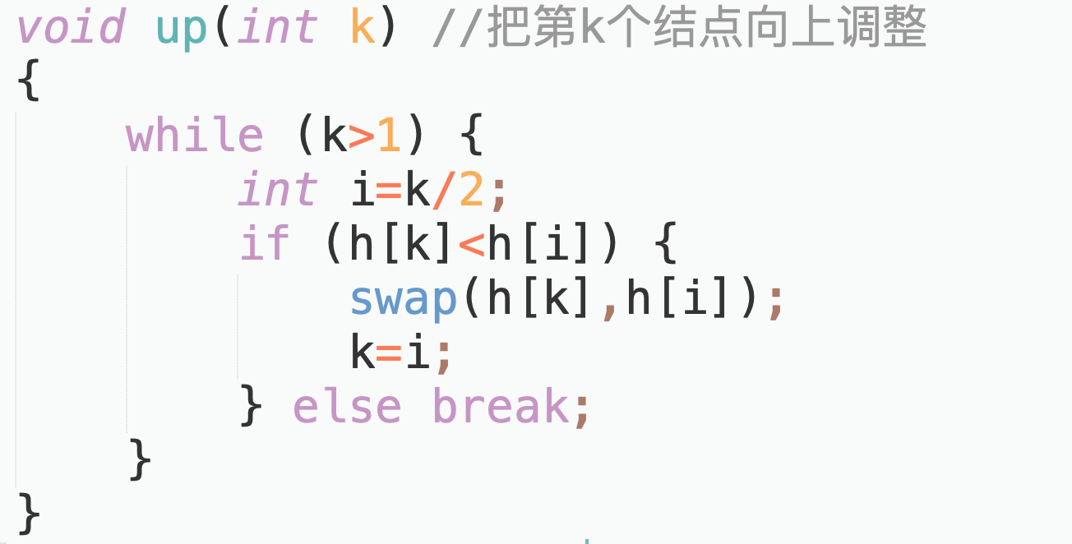
Insertion (a process of swapping upwards)
Swap node K up

Slide 10
Deleting the root node from the heap
The process is as follows:
First, swap the the root node with the node at the end, then delete the node at the end. This will delete the node previous as the root.
Then, the new node at the root is repeatedly swapped down until the heap characteristics is satisfied again.

Slide 11
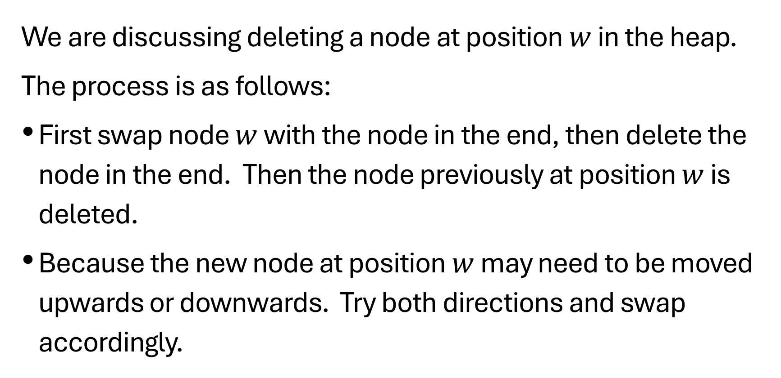
DeletING any node from the heap
We are discussing deleting a node at position $w$ in the heap.
The process is as follows:
First swap node $w$ with the node in the end, then delete the node in the end. Then the node previously at position $w$ is deleted.
Because the new node at position $w$ may need to be moved upwards or downwards. Try both directions and swap accordingly.

Slide 12
1
1
2
5
4
5
3
5
7
8
3
5
7
8
6
4
6
2
(1) The node to be deleted is the left child of the root.
(2) Swap the left child of the root with the node at the end.
1
3
5
4
5
7
8
6
(3) Repeatedly swap the new node down until the heap characteristics is satisfied.

Slide 13
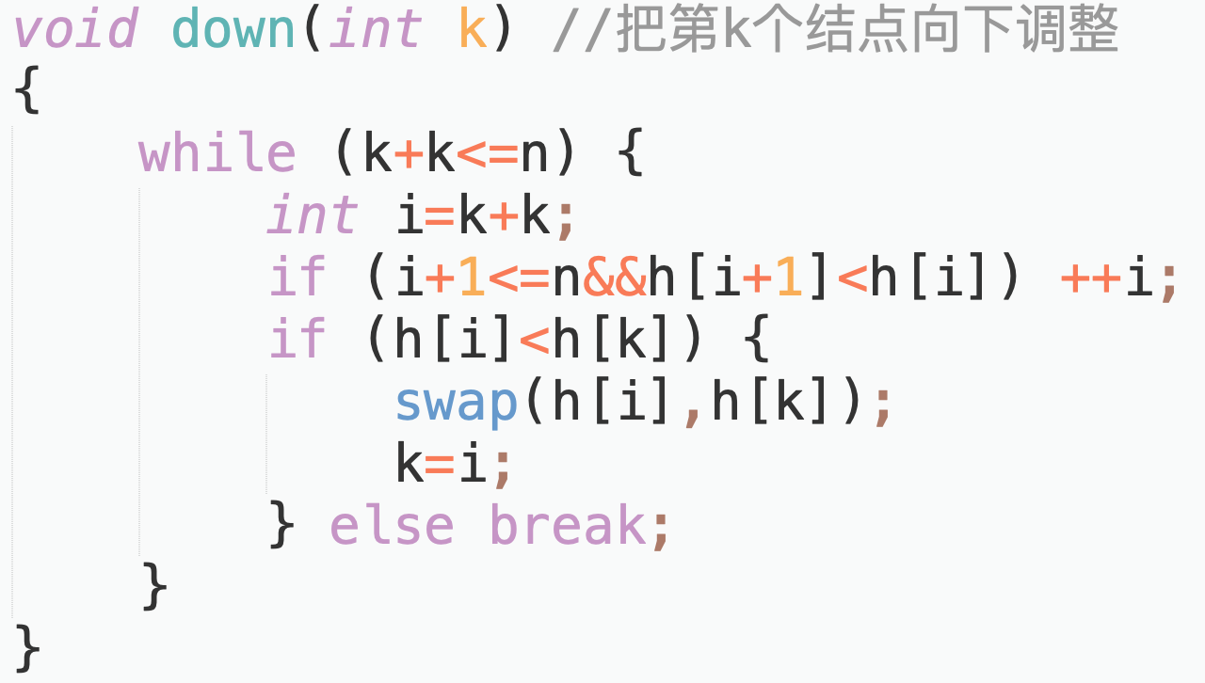
Deletion (a process of swapping downwards)
Swap node K down

Slide 14
construction of a heap is the process of repeated insertions
6
2
3
5
1
Insert elements with weights of 6, 2, 3, 5, and 1 respectively.
2
2
6
(1)
6
6
3
(2)
(3)
2
1
5
3
2
3
6
6
5
(4)
(5)

Slide 15
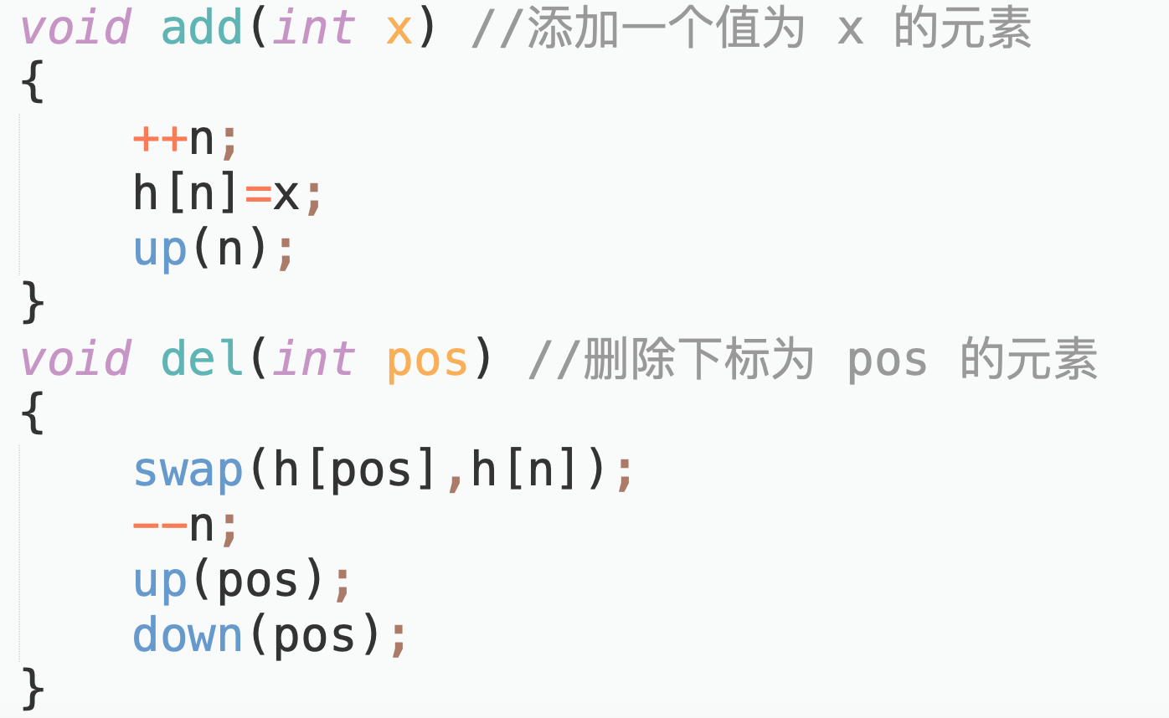
Insertion / deletion of a heap
Insert node w/ weight k
Delete node at pos. x
Notes:
void del_v (int x) { // Delete an element with value
int pos = find(x);
if (pos) del(pos);
}

Slide 16
Priority queues (STL)
priority_queue: max-heap
priority_queue <int, vector<int>, greater<int>> pq; // min-heap
priority_queue <type> pq; // Custom struct with operator overloading
priority_queue <type, vector<type>, cmp> pq; // Custom struct + comparison function
Only the top element of the heap can be deleted; arbitrary elements cannot be deleted.

Slide 17
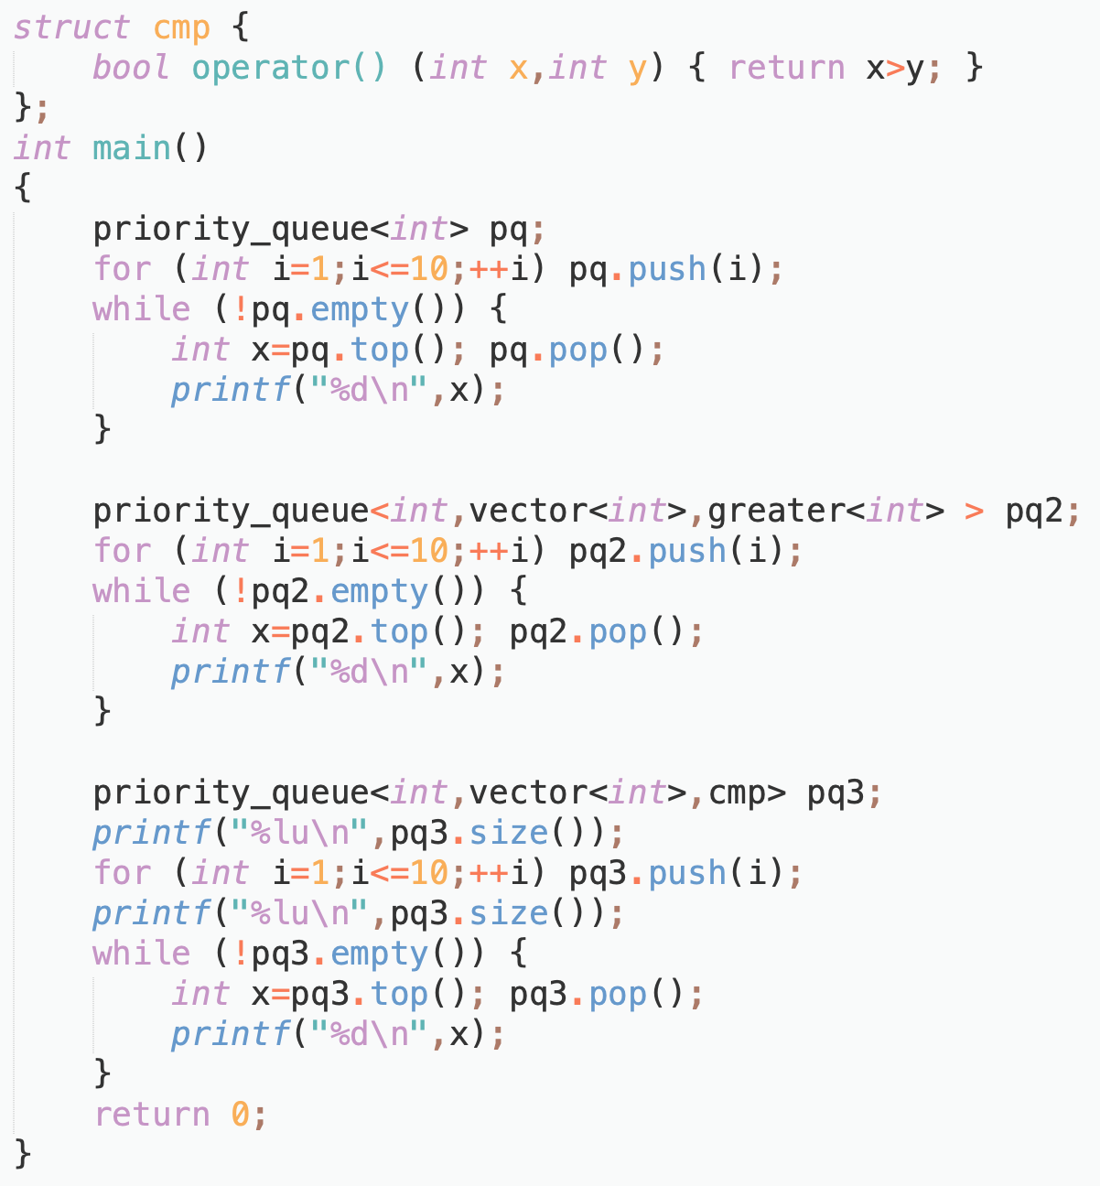
priority_queue
Max-heap
Common operations:
  Check if it is empty: empty()
  Number of elements: size()
  Retrieve the top of the heap: top()
  Insert into the heap: push()
  Popping from the heap: pop()
Custom comparison functions
No method to delete any element

Slide 18
Thank YOU

